Slide 1
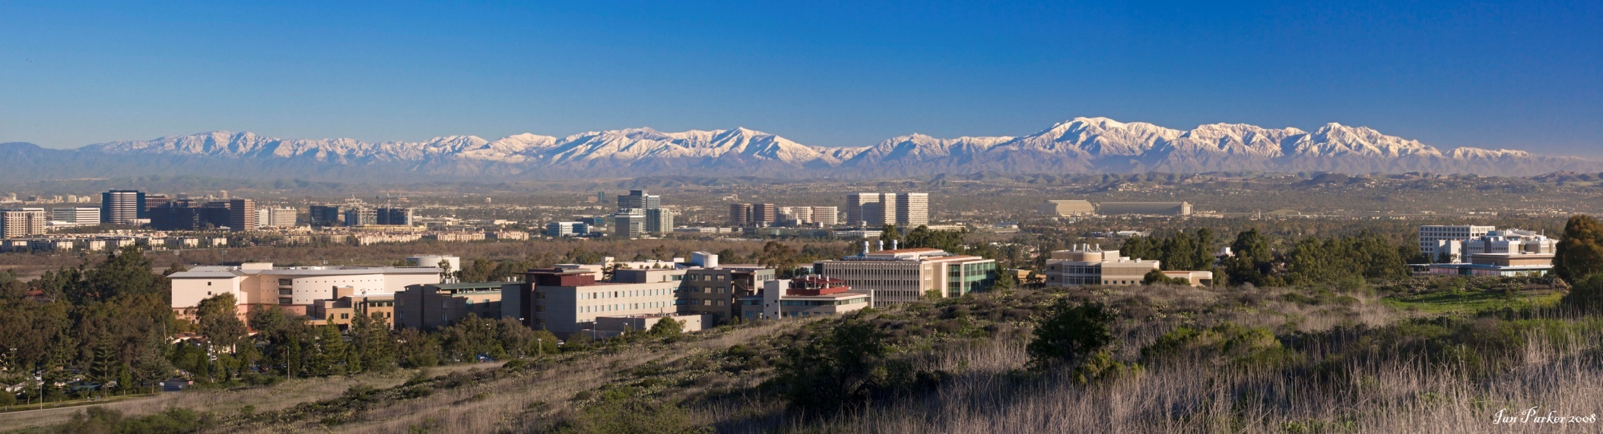
Two distinct modes of IP₃-mediated Ca²⁺ release during global Ca²⁺ spikes and waves
Re-examining an old question with some new techniques
Calcium Signalling Conference in Fez – 10/29/2019
UCI campus on a clear winter day
Ian Parker, Jeff Lock
Departments of Neurobiology & Behavior, Physiology & Biophysics, University of California, Irvine

Slide 2
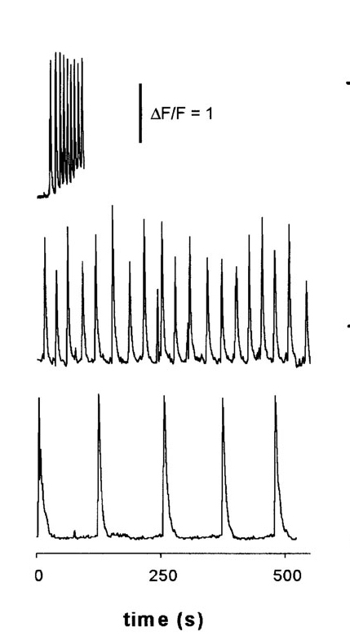

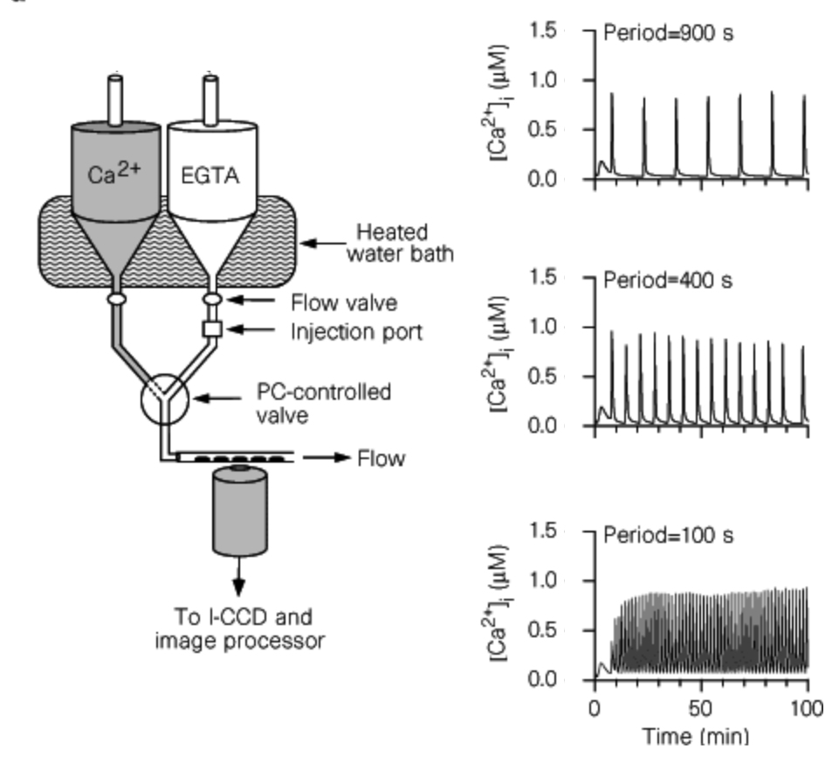
Ca²⁺ oscillations as frequency-encoded transmission of information
Increasing [IP₃]
Ca² ⁺ oscillations – repetitive spikes in global, cell-wide [Ca²⁺] – evoked at increasing frequency by increasing [IP₃]
Ca² ⁺ clamp technique to induce repetitive, spatially and temporally homogeneous cytosolic Ca² ⁺ spikes of
~ 1 μM

Slide 3
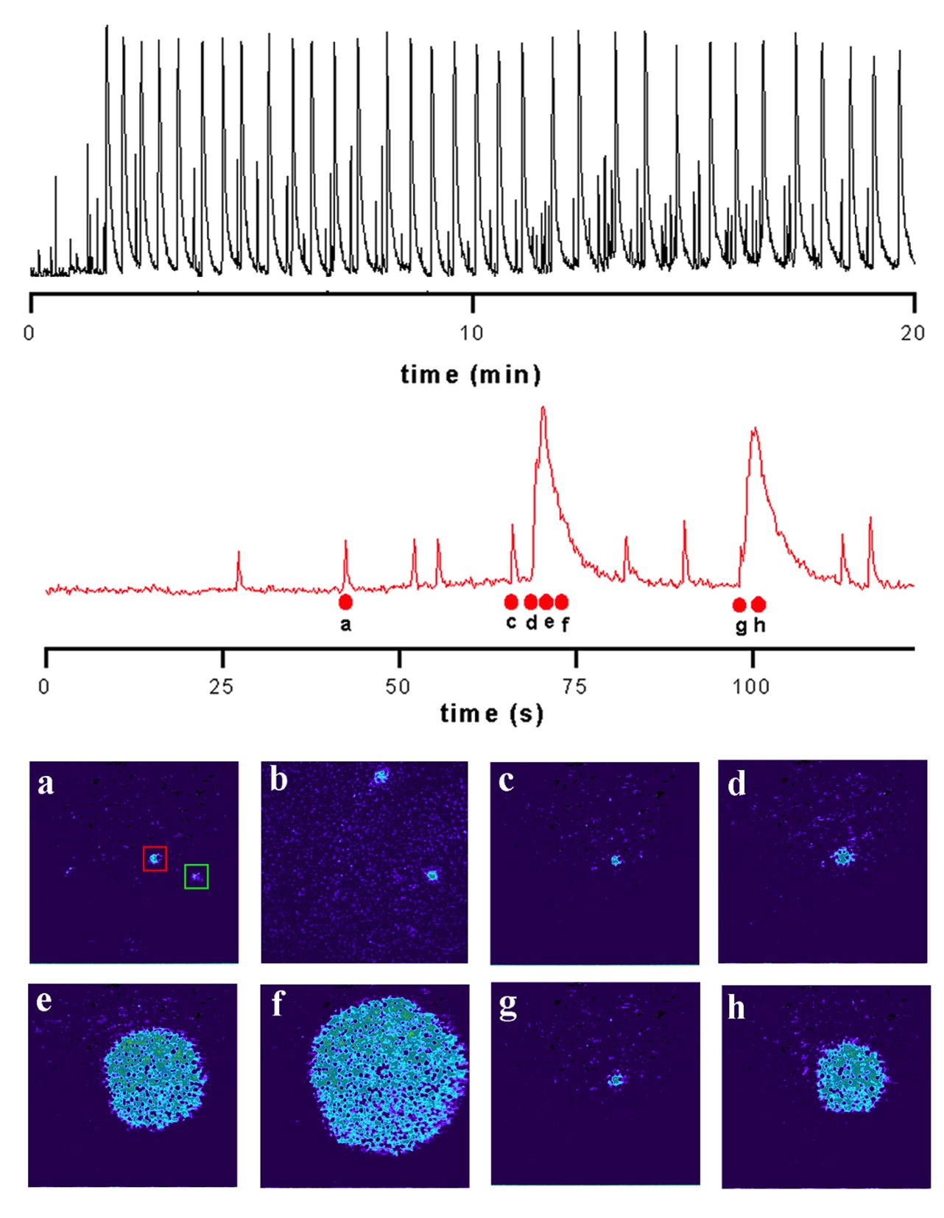
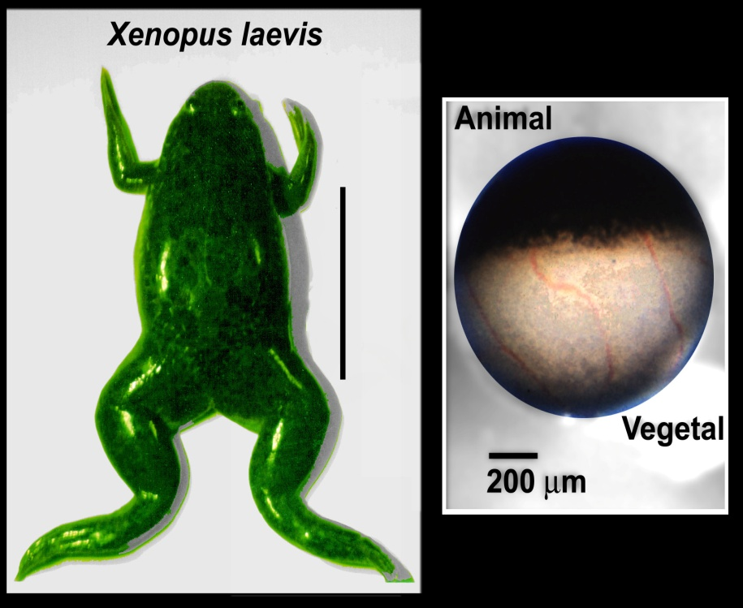
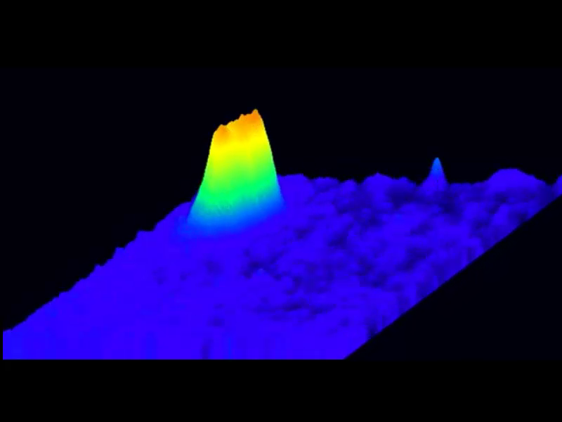
Do IP₃-mediated Ca²⁺ spikes actually represent gradual (seconds), spatially homogeneous Ca² ⁺ elevations throughout the cytoplasm?
A hierarchy of IP₃-mediated Ca²⁺ signals: Oscillatory waves and transient, localized Ca²⁺ puffs
Xenopus oocyte
Marchant & Parker. Role of elementary Ca²⁺ puffs in generating repetitive Ca²⁺ oscillations. EMBO J., 2001.

Slide 4
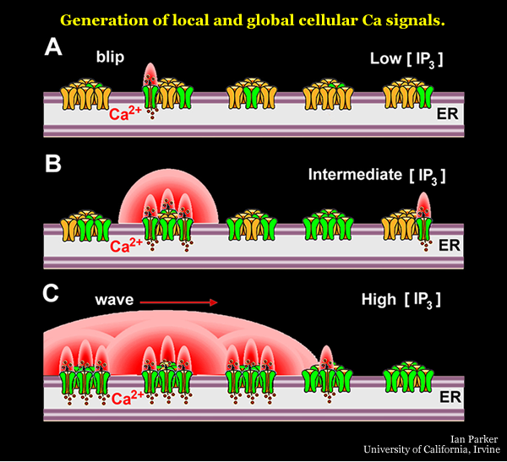
Factors determining the spatiotemporal patterning of IP₃-mediated Ca²⁺ signals
  The properties of the IP₃ receptor (positive and negative feedback by Ca²⁺)
  The spatial arrangement (clusters) of IP₃ receptors
blip
Ca²⁺
puff
puff
IP₃
+
-
global spike?
cytoplasm
ER
IP₃ receptor (IP₃R)
These signals are the “phonemes” of the language of calcium signaling.
Notes:
4

Slide 5

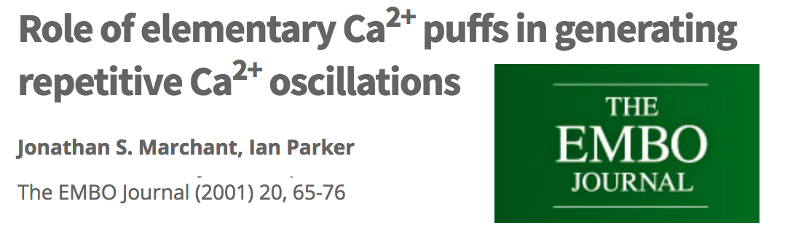
How and where is Ca²⁺ liberated in a cell during global, IP₃-mediated Ca²⁺ spikes?
These papers, and others, examined the transition from transient, local puffs to the regenerative global Ca²⁺ spike, but not the mode of Ca²⁺ liberation during the global spike.
Questions
1. How is Ca²⁺ liberated during a global spike? As a flurry of coordinated puffs, or is there also a spatially and temporally more uniform liberation of Ca²⁺? Are puffs the ‘universal building blocks’ of IP₃-mediated cellular Ca²⁺ signalling.
2. Where in the cell is Ca²⁺ liberated? Only from clusters of IP₃R primarily adjacent to the plasma membrane, or from IP₃Rs distributed throughout the cell?
These questions have been difficult to answer, because puffs become obscured by the much greater rise of cytosolic [Ca²⁺] during global spikes.

Slide 6
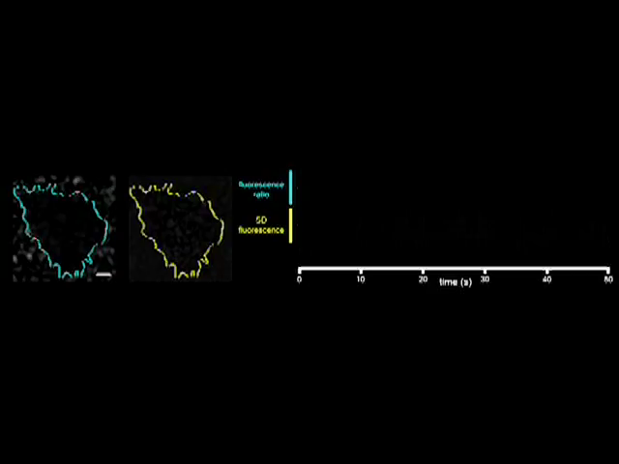
Fluctuation processing greatly enhances visualization of local Ca²⁺ puffs
TIRF imaging: HEK WT cell, loaded with Cal520, caged i-IP₃ and EGTA to inhibit global Ca²⁺ spikes
‘raw’ Cal520 fluorescence
SD signal
5 um
standard deviation (SD)
SD signal reflects pixel-by-pixel fluctuations in fluorescence over a running time window

Slide 7
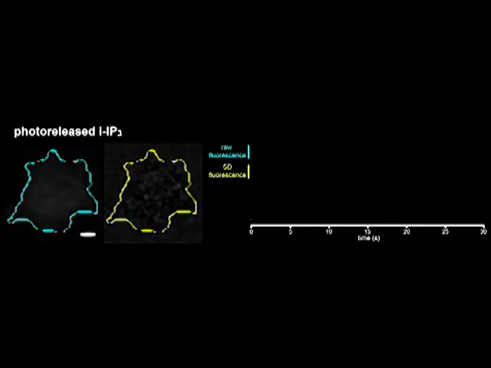
Fluctuation analysis reveals a flurry of Ca²⁺ puffs during the rising phase of IP₃-evoked global Ca²⁺ spike
TIRF imaging: HEK WT cell, loaded with Cal520 and caged i-IP₃
‘raw’ Cal520 fluorescence
SD signal
5 um
standard deviation (SD)
SD signal reflects pixel-by-pixel fluctuations in fluorescence over a running time window
HEK WT cell, loaded with caged i-IP3

Slide 8
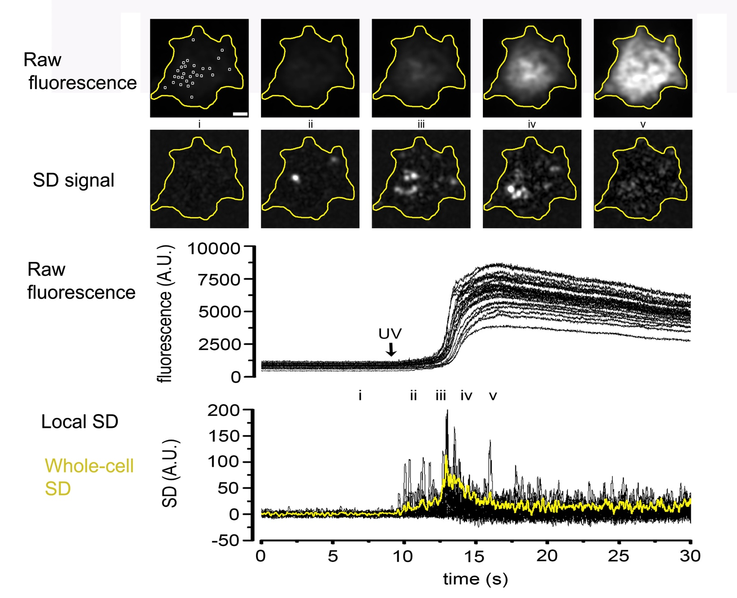
Fluctuation analysis reveals a flurry of Ca²⁺ puffs during the rising phase of IP₃-evoked global Ca²⁺ spike

Slide 9
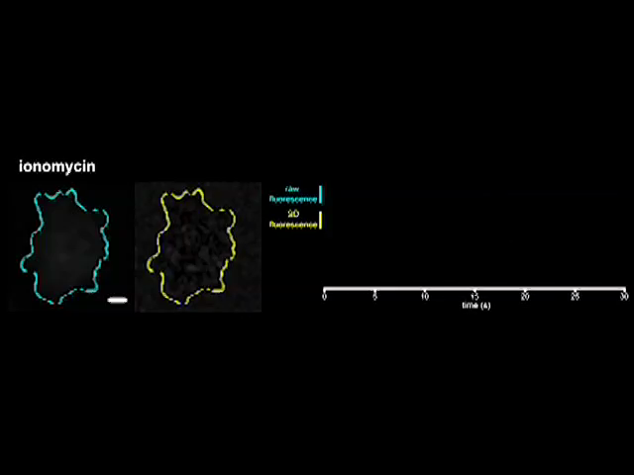
CONTROL - Ca²⁺ elevation induced by ionomycin is not accompanied by an increase in Ca²⁺ fluctuations
TIRF imaging: HEK IP3R null cell
‘raw’ Cal520 fluorescence
SD signal
5 um
SD signal reflects pixel-by-pixel fluctuations in fluorescence over a running time window

Slide 10
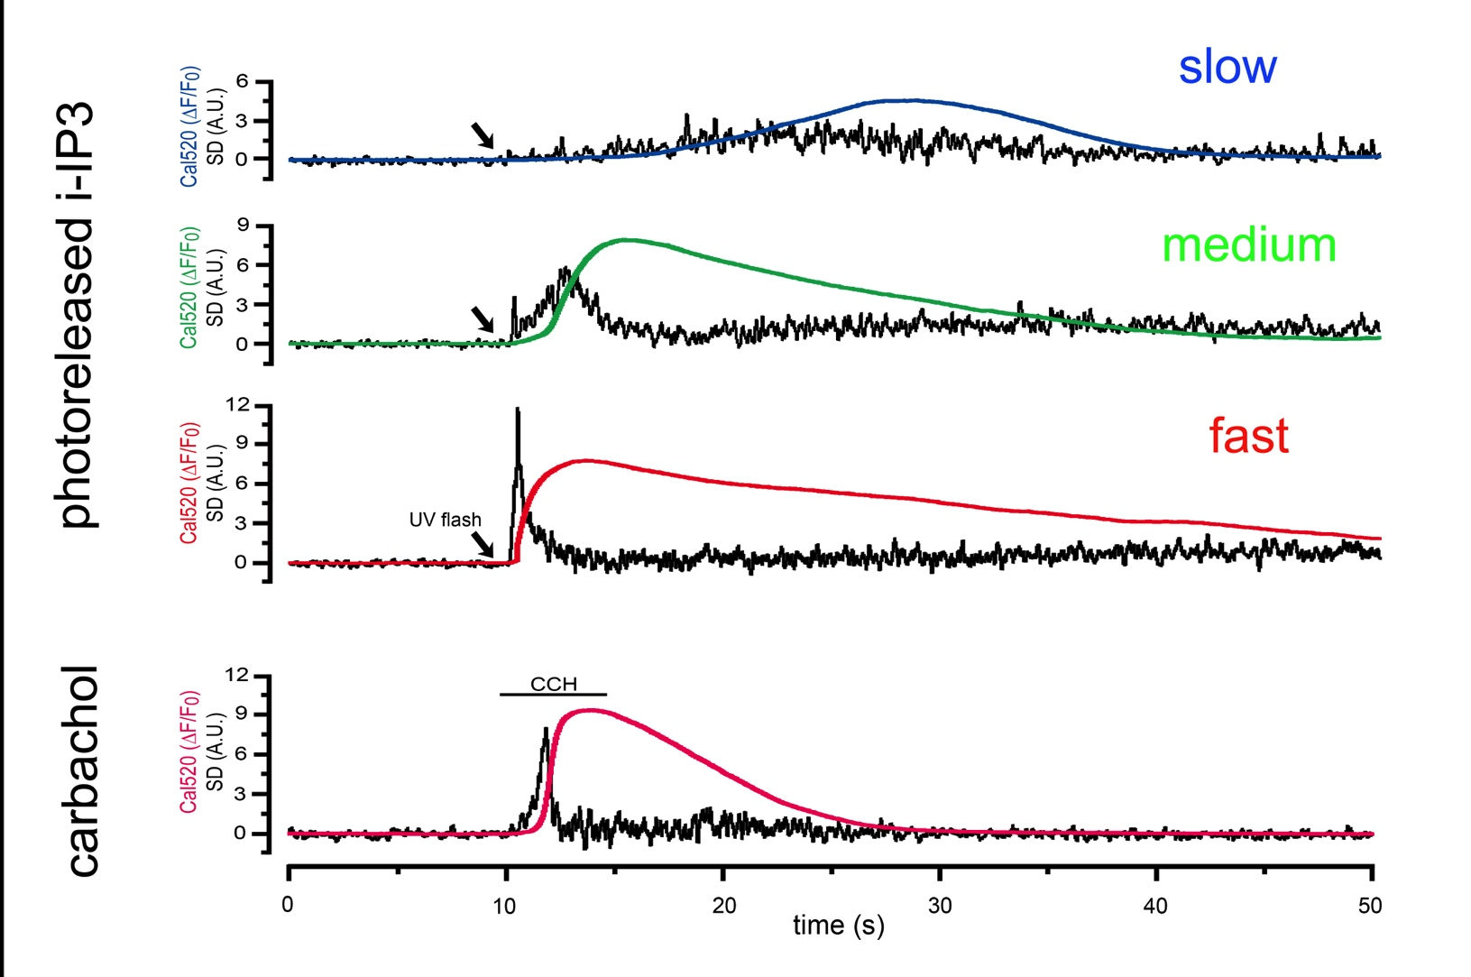
Two distinct modes of Ca²⁺ liberation during IP₃-evoked spikes:
An initial flurry of puffs (‘punctate’ release) then a temporally and spatially smoother ‘diffuse’ release.
All experiments done in zero Ca²⁺ + 0.3 mM EGTA bathing solution to avoid complications from Ca²⁺ influx: But similar results in normal 2 mM Ca²⁺ bathing solution.

Slide 11
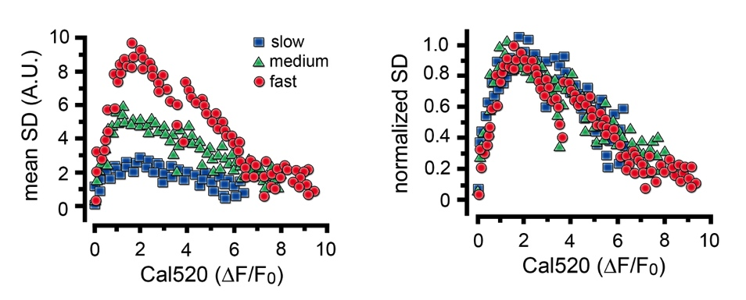
Puff activity during the rising phase of the Ca²⁺ spike tracks the rising global level of [Ca²⁺]
Increasing puff activity
Increasing global [Ca²⁺]

Slide 12
Puff activity during the rising phase of the Ca²⁺ spike tracks the rising global level of [Ca²⁺]
These curves look very much like the classic bell-shaped curve for Ca²⁺-dependence of IP₃R channel opening. Are puffs suppressed as global [Ca²⁺] becomes high during a spike?
Increasing puff activity
Increasing global [Ca²⁺]

Slide 13
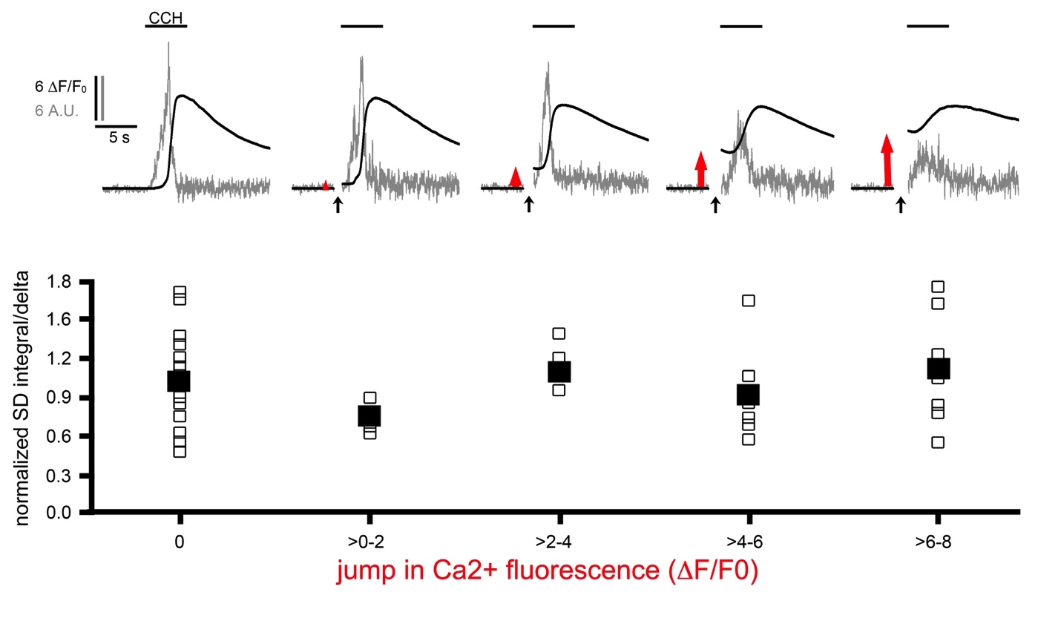
NO! Ca²⁺ puffs persist when cytosolic Ca²⁺ is elevated
Ca²⁺ jumps evoked by photolysis of caged Ca²⁺ do not suppress puff activity during subsequent IP₃-mediated spikes
Normalized ratio
SD/peak global Ca²⁺

Slide 14
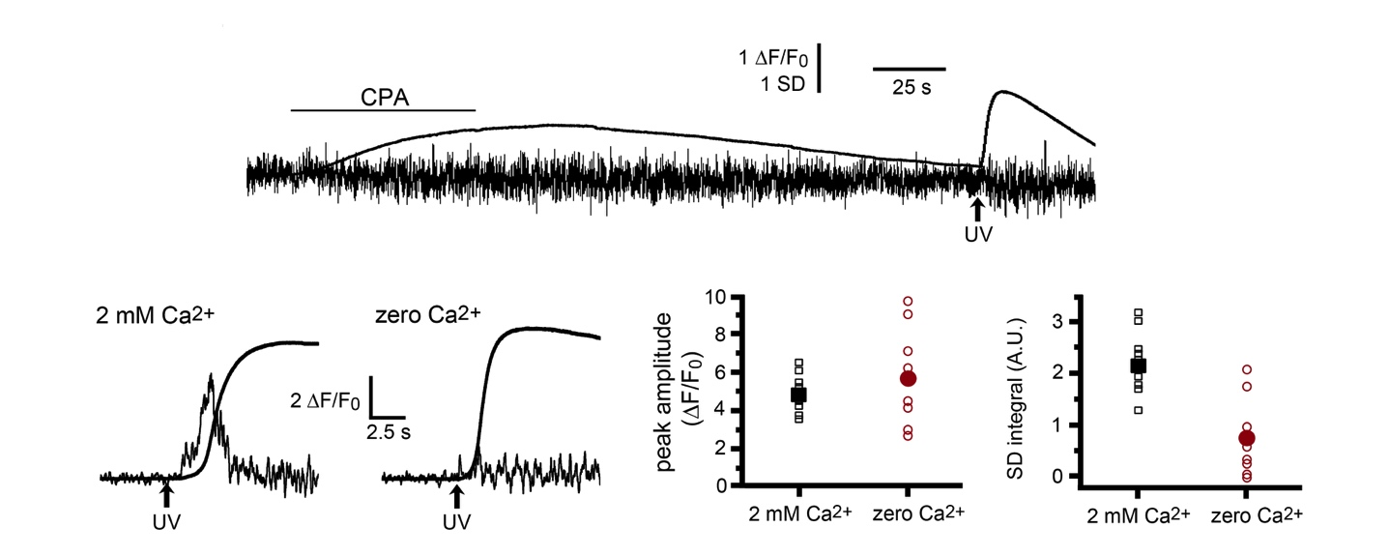
Partial depletion of ER Ca²⁺ content suppresses puff activity
SD and global [Ca²⁺] signals evoked by photoreleased i-IP₃ following transient treatment with CPA to deplete ER Ca²⁺ store.
zero Ca²⁺
2mM extracellular Ca ²⁺ to allow ER refilling
Zero extracellular Ca ²⁺ to inhibit ER refilling

Slide 15
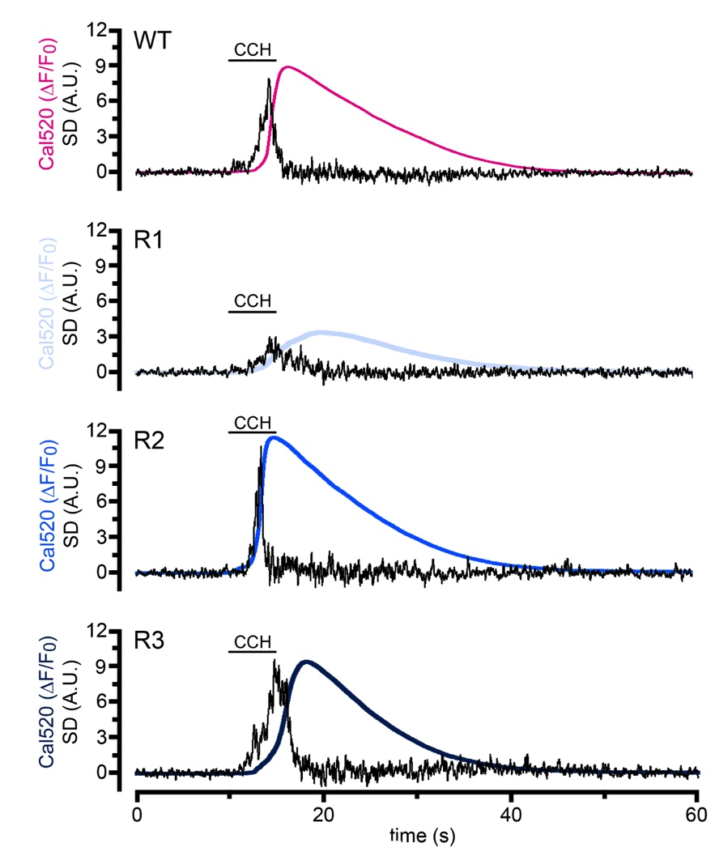
All three IP₃R isoforms mediate both punctate and diffuse modes of Ca²⁺ liberation
Wild-type
IP₃R1
IP₃R2
IP₃R3
SD and global [Ca²⁺] signals evoked by carbachol in HEK cells genetically-engineered to exclusively express single IP₃R isoforms

Slide 16
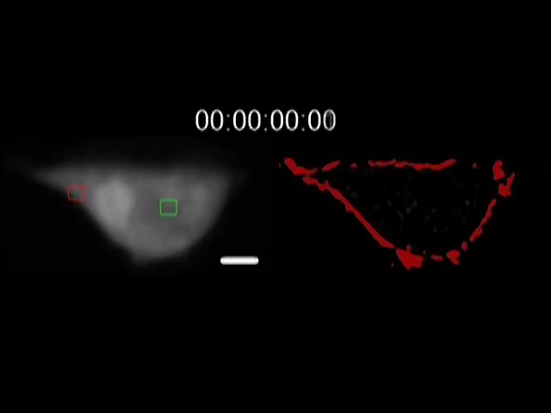
TIRF imaging visualizes only signals arising near the PM.
What’s happening in the cell interior?
Light-sheet imaging of puffs in an EGTA-loaded HEK293 cell
10 um
‘raw’ Cal520 fluorescence
standard deviation (SD)
plasma membrane

Slide 17
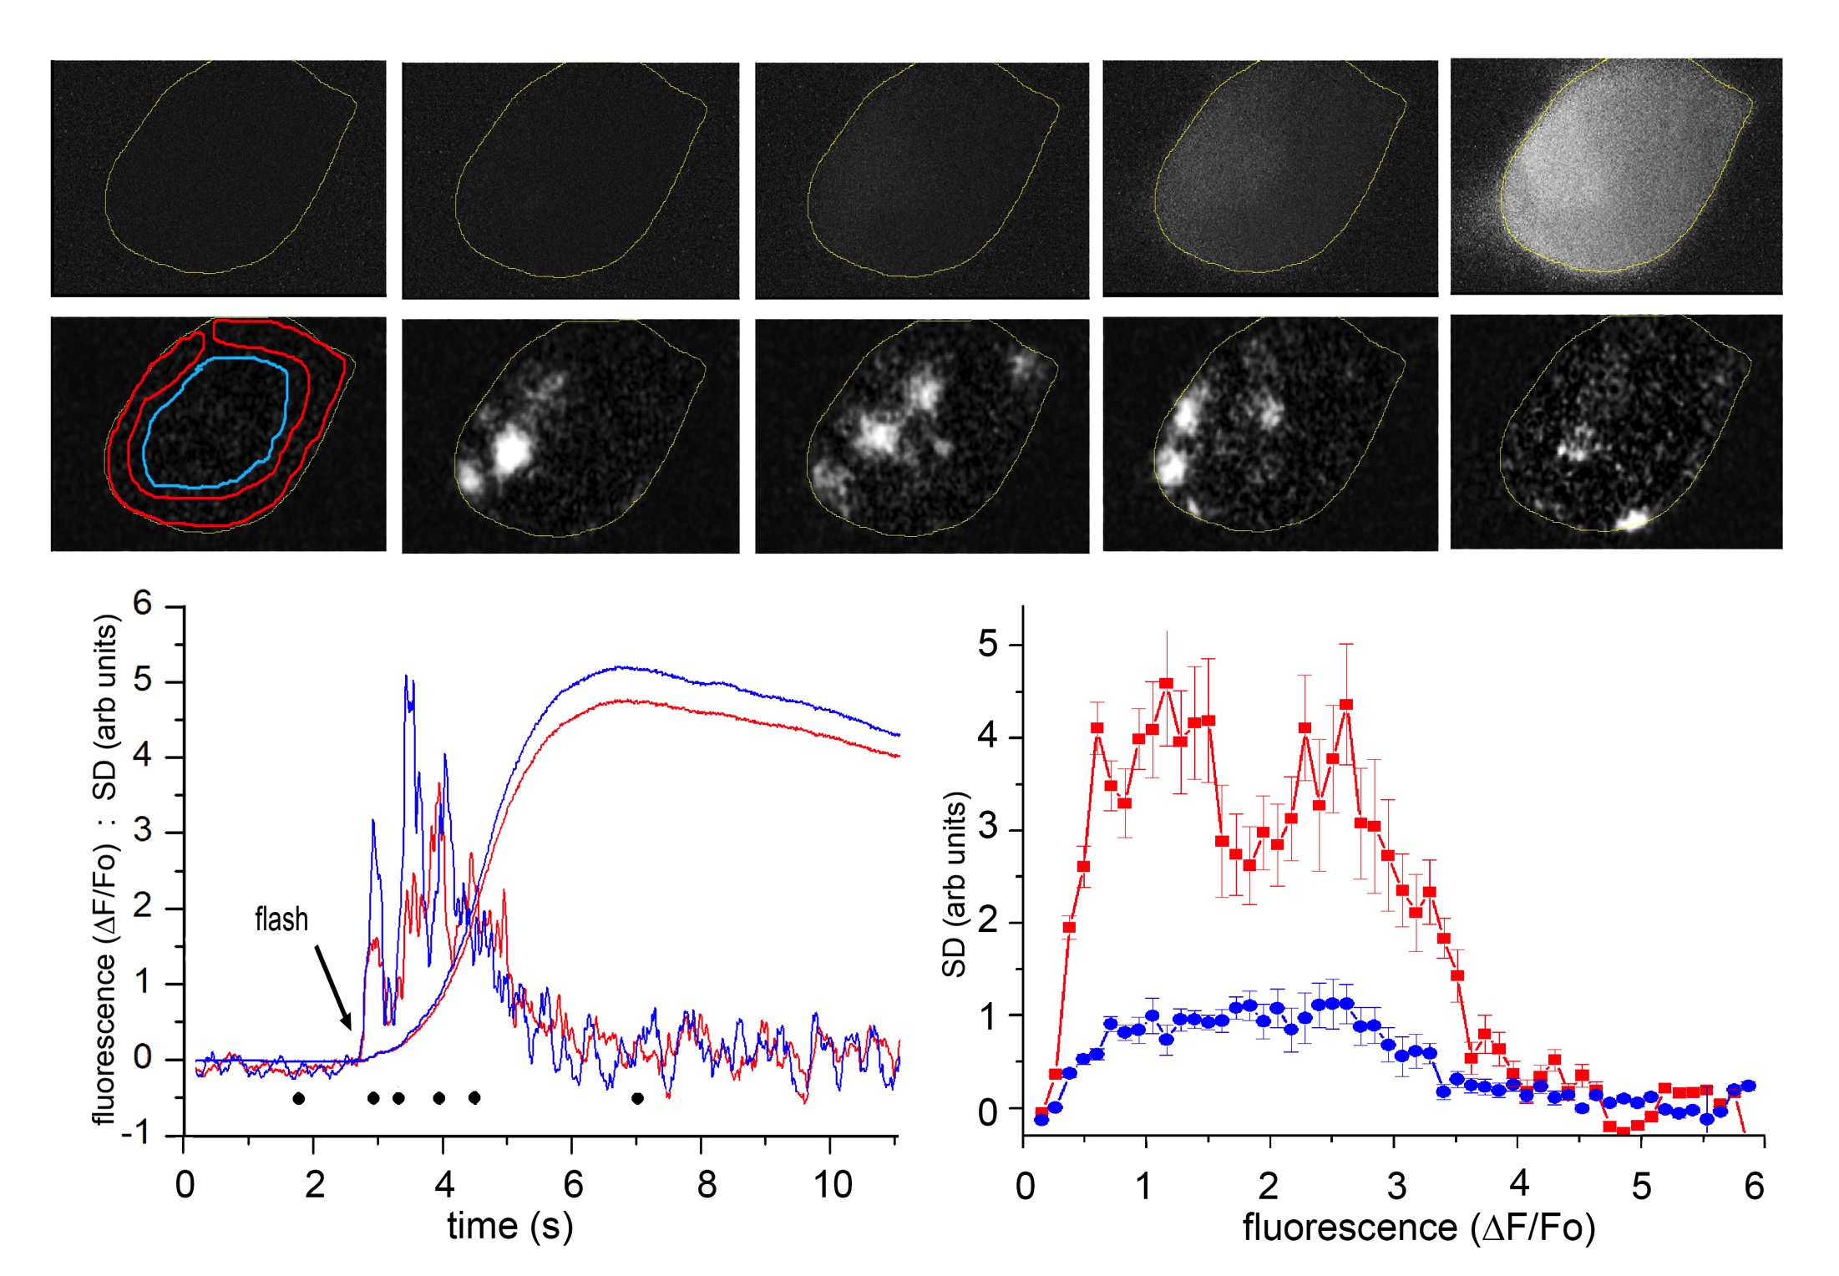
Ca²⁺ signals in the cell interior show pulsatile and diffuse patterns similar to signals near the PM imaged by TIRF
Light-sheet imaging of an i-IP₃-evoked global Ca²⁺ spike in a HEK293 cell
Raw fluorescence
SD signal
periphery
interior

Slide 18
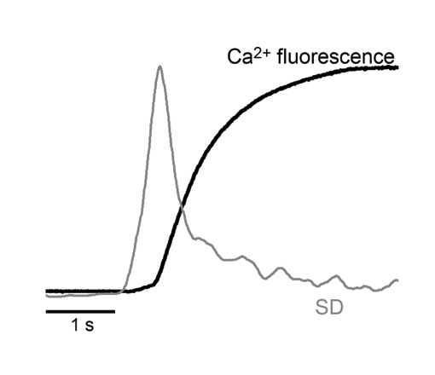
What proportion of the Ca²⁺ released during Ca²⁺ spikes arises from puffs vs. diffuse release
Typical Ca²⁺ fluorescence trace and SD signal during the initial phase of a global Ca²⁺ spike
[All traces are shown normalized to the same peak height]

Slide 19
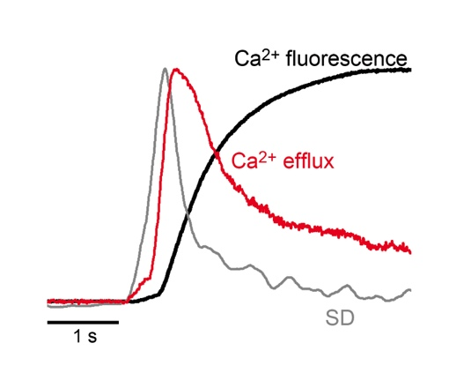
What proportion of the Ca²⁺ released during Ca²⁺ spikes arises from puffs vs. diffuse release
Calculate Ca²⁺ efflux rate from differential of Ca²⁺ fluorescence trace minus estimated rate of Ca²⁺ sequestration from cytosol

Slide 20
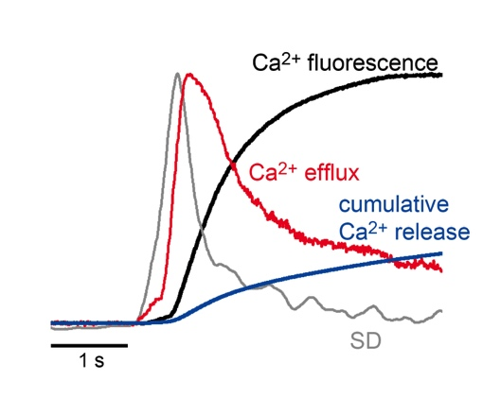
What proportion of the Ca²⁺ released during Ca²⁺ spikes arises from puffs vs. diffuse release
Calculate cumulative amount of Ca²⁺ released by integrating under the Ca²⁺ efflux curve

Slide 21
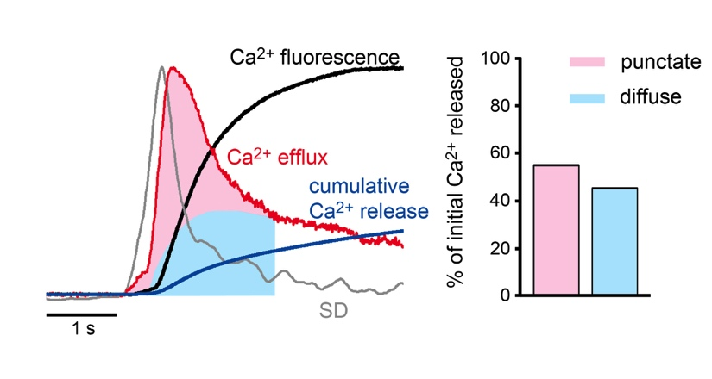
What proportion of the Ca²⁺ released during Ca²⁺ spikes arises from puffs vs. diffuse release
Ca²⁺ released during the initial rise of a global Ca²⁺ spike comes about equally from puffs (pink area under efflux curve ) and from diffuse release (blue area)

Slide 22
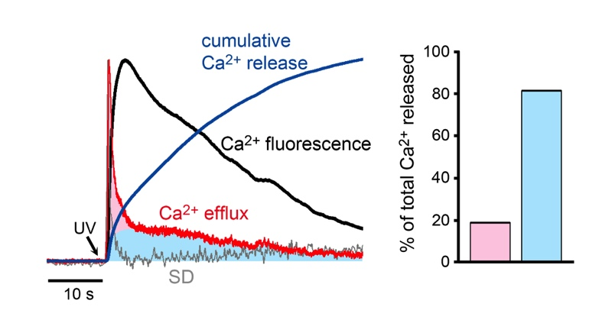
What proportion of the Ca²⁺ released during Ca²⁺ spikes arises from puffs vs. diffuse release
But Ca²⁺ released from puffs (pink area under efflux curve) is only about 20% of the total Ca2+ released during the entire time course of a Ca²⁺ spike (blue area)

Slide 23
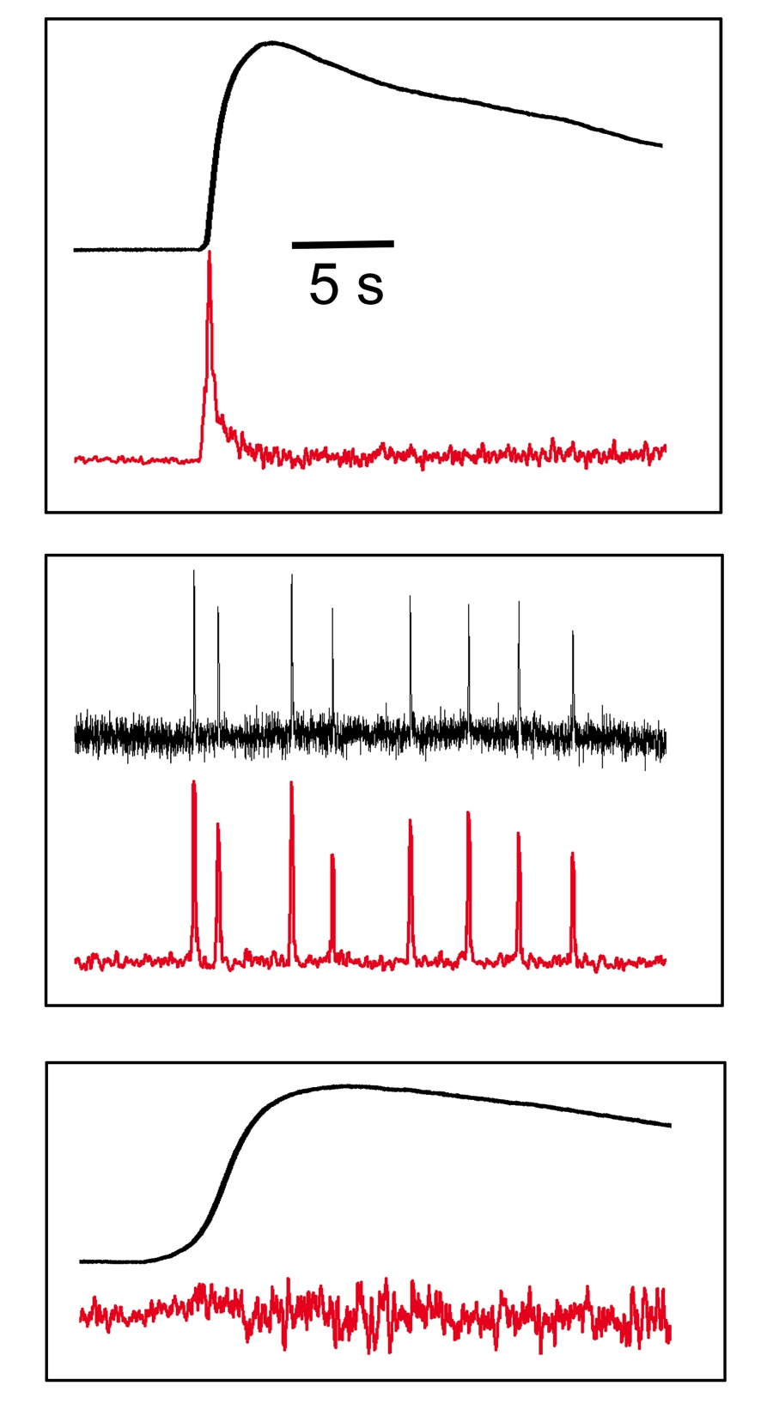
Two distinct modes of IP₃-mediated Ca²⁺ liberation during global Ca²⁺ spikes: punctate and diffuse
“Normal” Ca²⁺ spike;
Punctate and diffuse
Ca²⁺ liberation
Ca²⁺ spike evoked by photoreleased IP₃ or agonist activation in physiological condition
Global Ca²⁺ fluorescence
SD signal
Exclusive punctate release – only puffs
Response evoked when global Ca²⁺ elevation is suppressed by slow Ca²⁺ buffer
Exclusive diffuse
release
Response evoked when puffs are suppressed by partial depletion of ER Ca²⁺

Slide 24
Some questions…
Generation of punctate and diffuse Ca²⁺ signals
What causes the flurry of puffs to terminate? Local depletion of ER Ca²⁺ by puffs themselves, or global depletion by diffuse release?
Which IP₃Rs are responsible for the diffuse release? Where are they?
Why do cytosolic slow Ca²⁺ buffers selectively inhibit diffuse release?
Downstream signalling
Effectors close to puff sites will experience transient pulses of high [Ca²⁺]. Ca²⁺ elevations distant from puff sites will be lower and more sustained.
How are effectors (Ca²⁺-binding proteins, channels, organelles) located and ‘tuned’ to respond to punctate vs. diffuse Ca2+ signals?

Slide 25
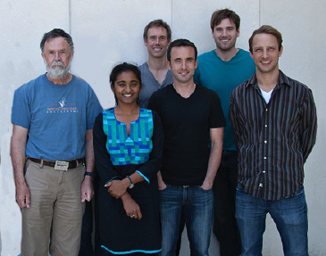
Acknowledgements
Kyle Ellefsen (wrote FLIKA software)
Divya Swaminathan (fluctuation analysis theory)
Jeff Lock (all experiments, analysis, wrote paper)
The NIH for support: [GM R37 048071, GM RO1 65830, GM F31 119330]

Slide 26
Some questions…
Generation of punctate and diffuse Ca²⁺ signals
What causes the flurry of puffs to terminate? Local depletion of ER Ca²⁺ by puffs themselves, or global depletion by diffuse release?
Which IP₃Rs are responsible for the diffuse release? Where are they?
Why do cytosolic slow Ca²⁺ buffers selectively inhibit diffuse release?
Downstream signalling
Effectors close to puff sites will experience transient pulses of high [Ca²⁺]. Ca²⁺ elevations distant from puff sites will be lower and more sustained.
How are effectors (Ca²⁺-binding proteins, channels, organelles) located and ‘tuned’ to respond to punctate vs. diffuse Ca2+ signals?

Slide 27
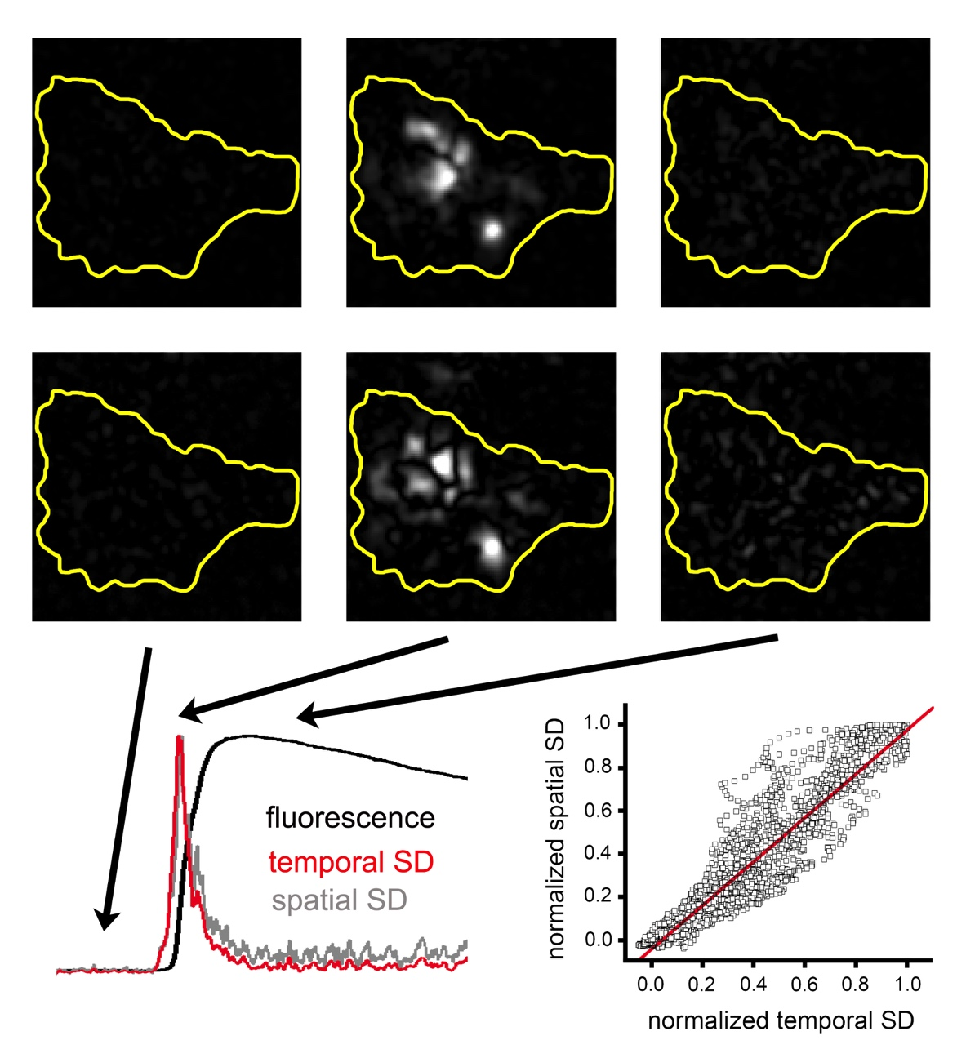
Fluctuations during a global Ca²⁺ spike arise from transient, localized Ca²⁺ signals (puffs)
Temporal fluctuations
Analysis by temporal and spatial fluctuation algorithms gives almost identical results.
Spatial fluctuations

Slide 28
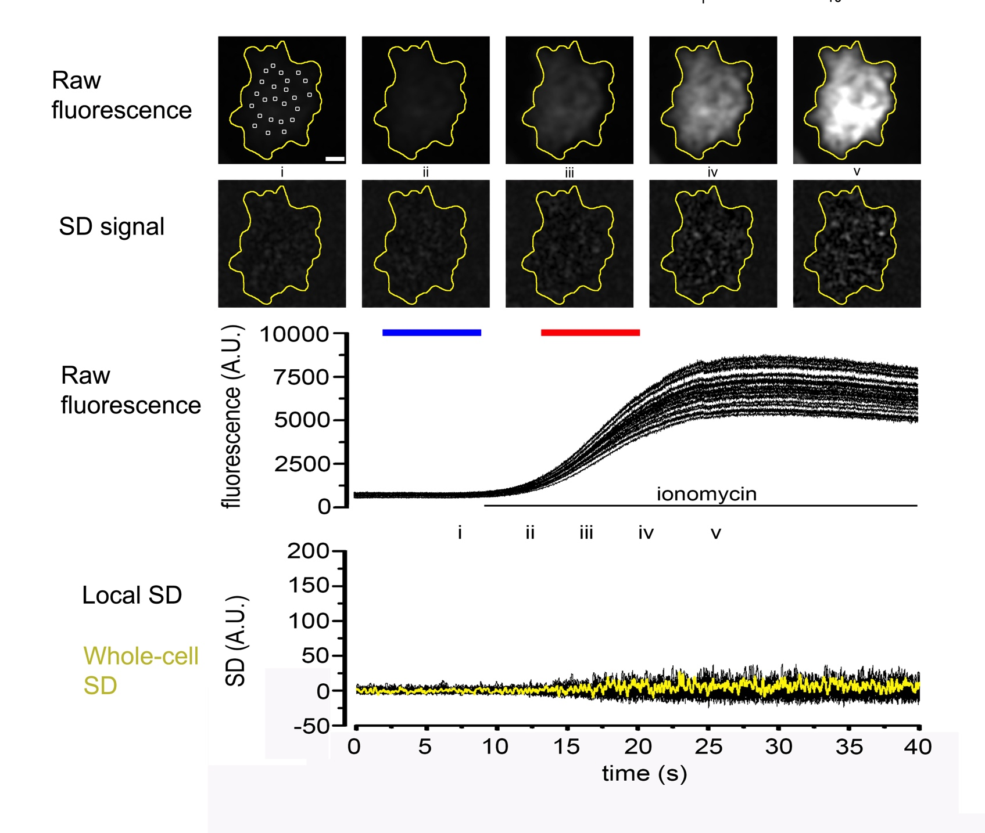
CONTROL - Ca²⁺ elevation induced by ionomycin is not accompanied by an increase in Ca²⁺ fluctuations

Slide 29
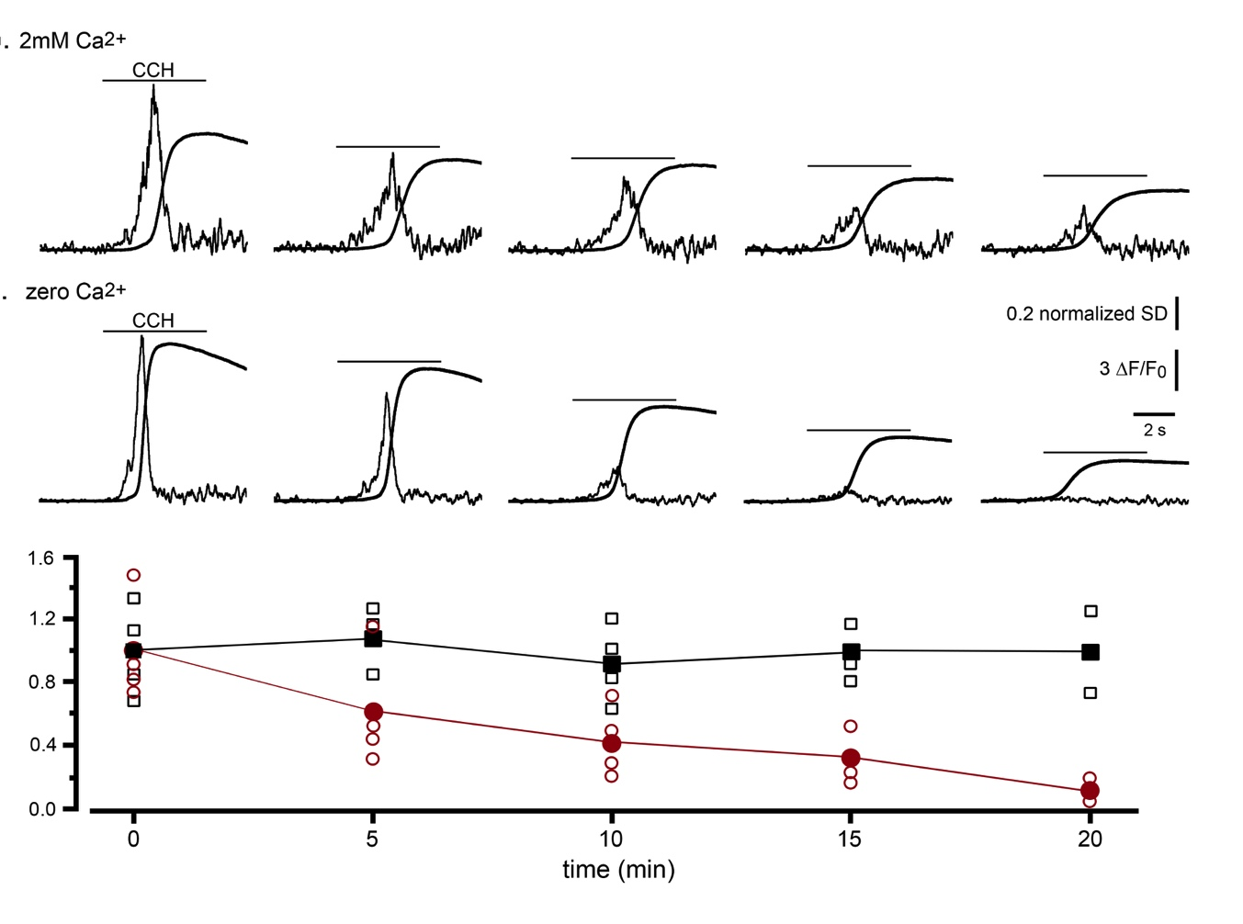
Partial depletion of ER Ca²⁺ content suppresses puff activity
SD and global [Ca²⁺] signals evoked by repetitive carbachol applications with extracellular solution containing zero or 2 mM Ca²⁺
2 mM Ca²⁺
Zero Ca²⁺
2 mM Ca²⁺
Zero Ca²⁺
Normalized ratio
SD/peak global Ca²⁺

Slide 30
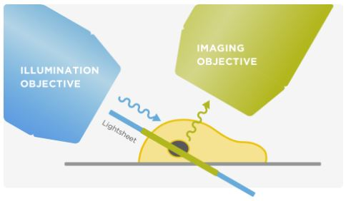
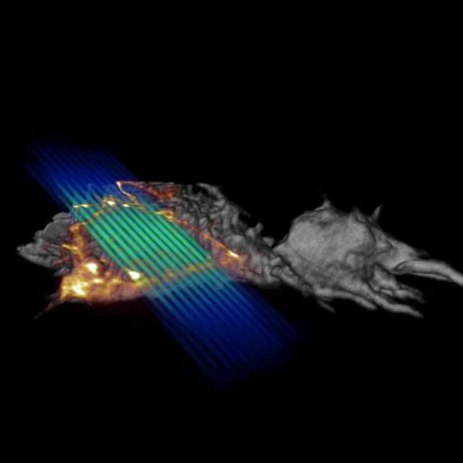
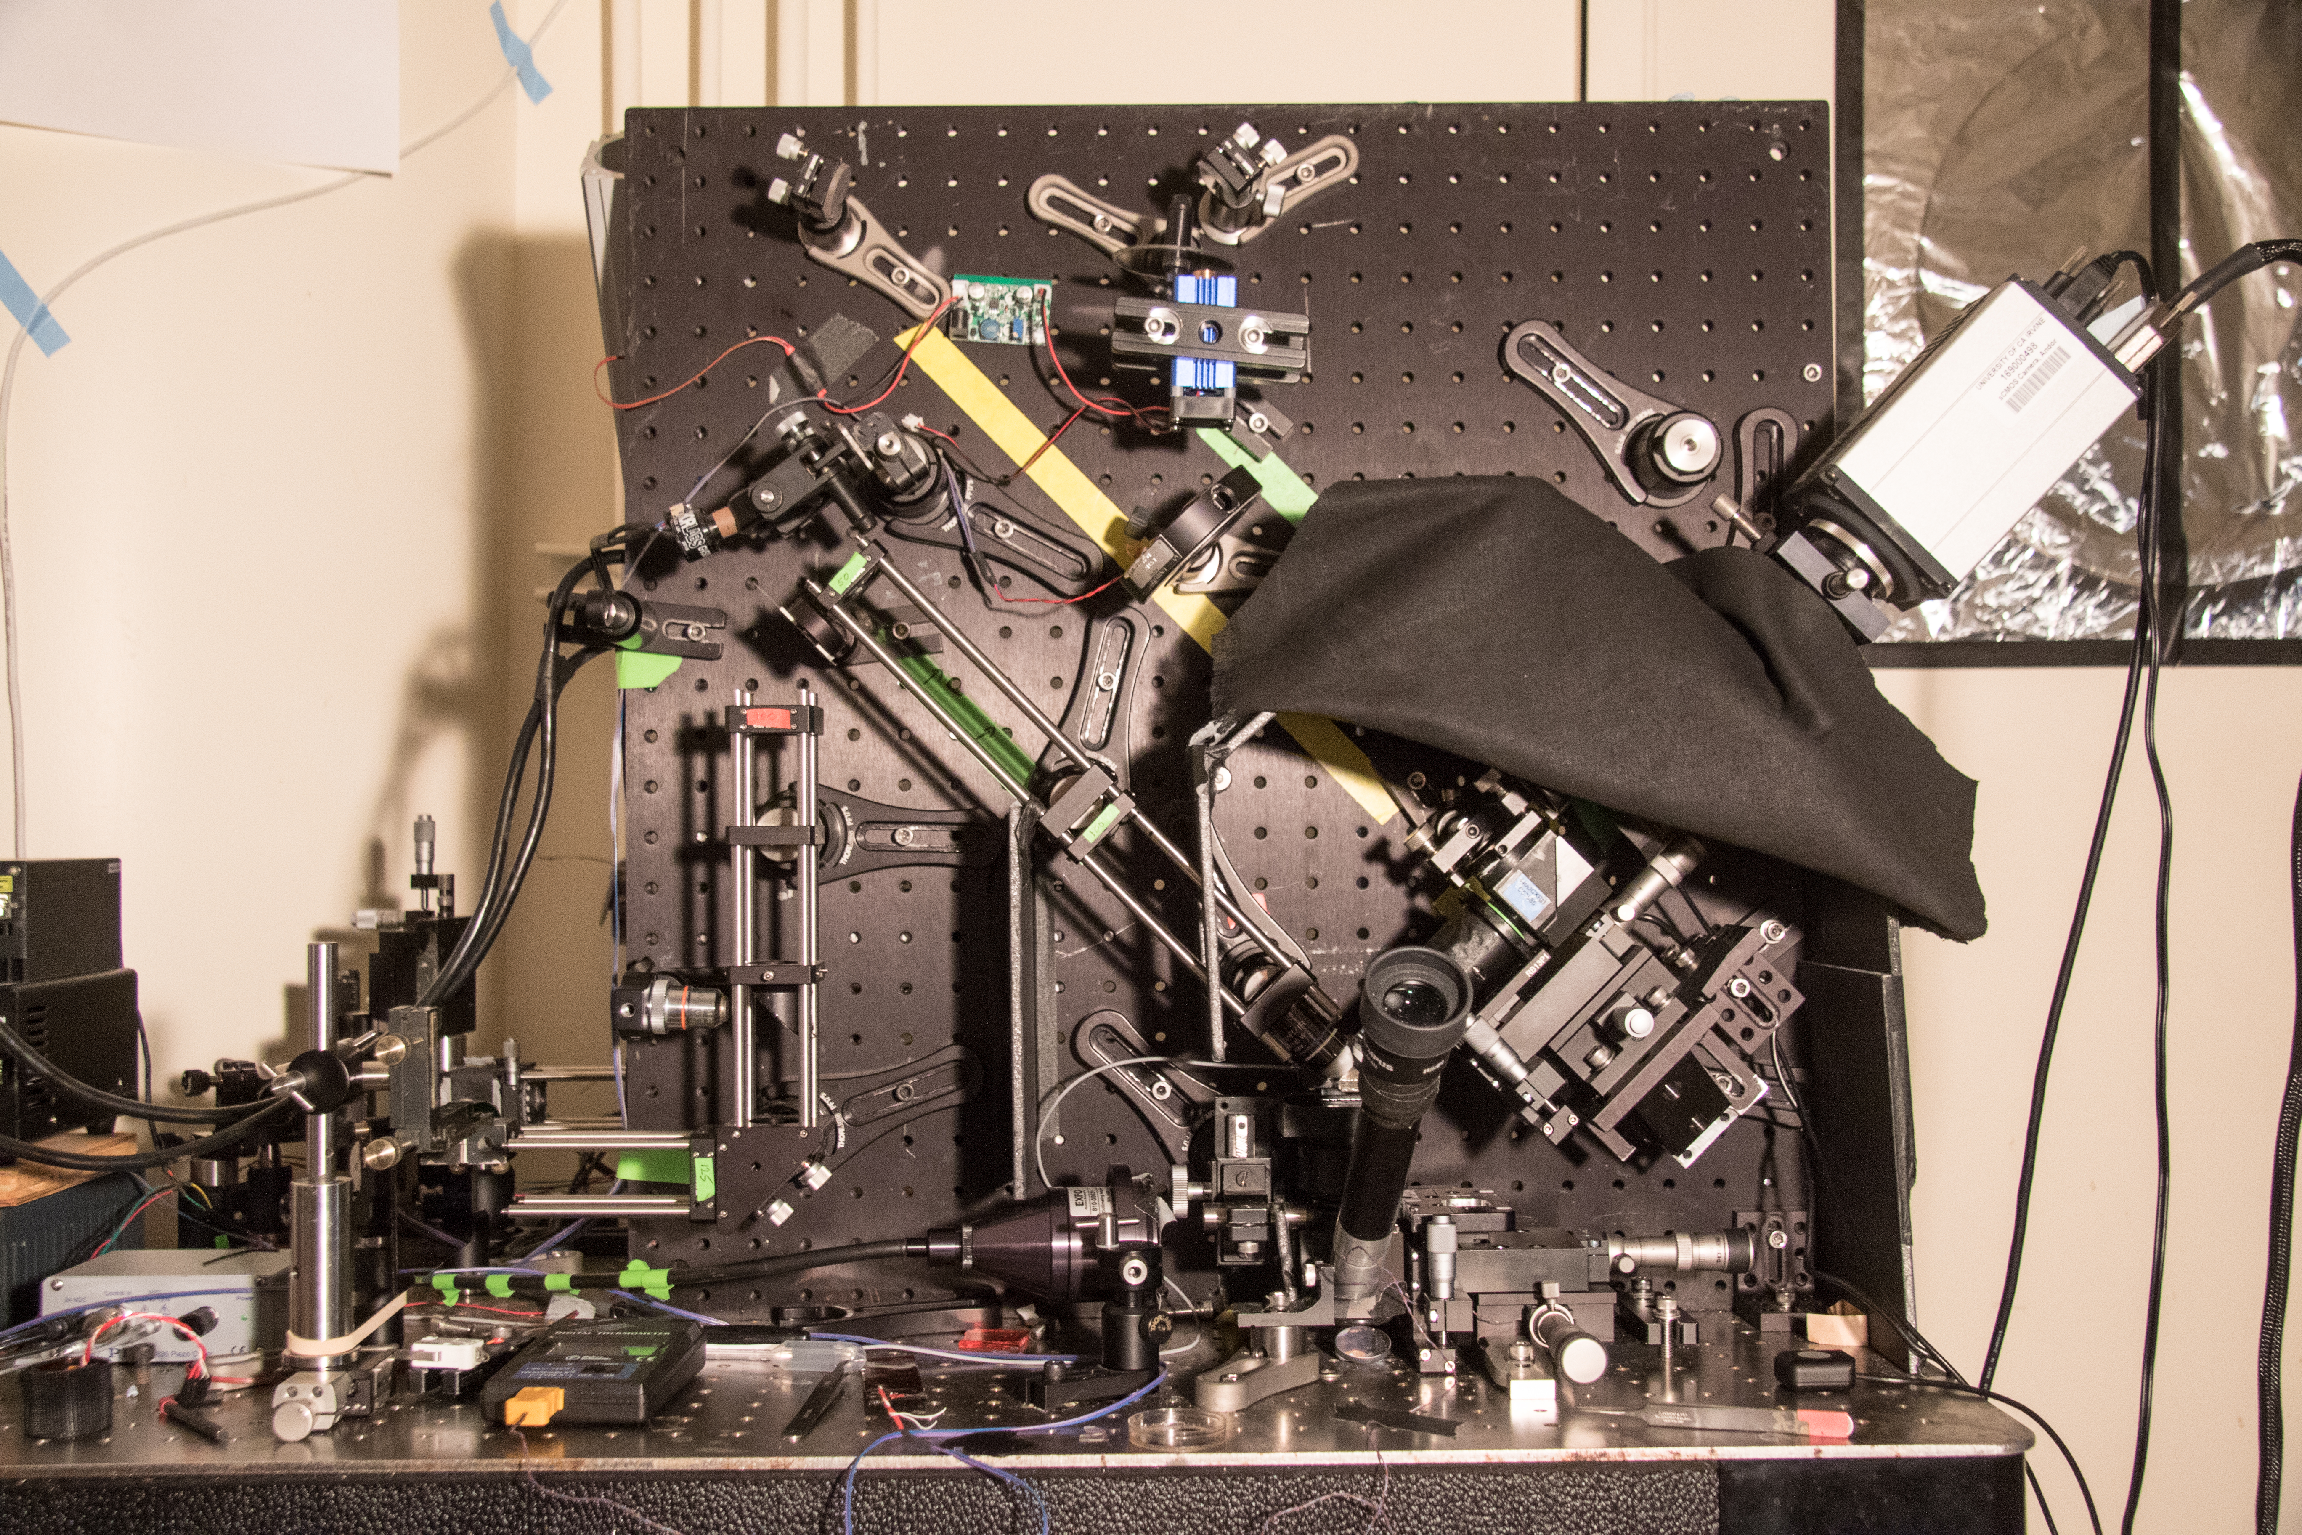
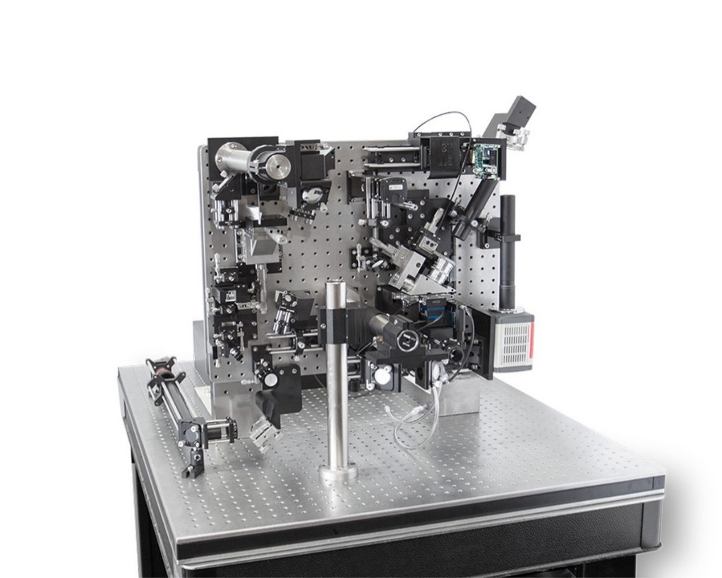
2. Light-sheet imaging:
Where is Ca²⁺ is liberated during global Ca²⁺ spikes?
Lattice light-sheet Imaging an optical section by projecting a thin sheet of light diagonally through cells
Homebrew LLS microscope
Betzig lab: DOI: 10.1126/science.1257998
A very thin light sheet is created by projecting a lattice of Bessel beams (‘narrow ‘rods’ of light)
Invented by Eric Betzig, who “believes that this development will have a greater impact than the work that earned him the 2014 Nobel Prize in Chemistry for "the development of super-resolved fluorescence microscopy”
Commercial LLS microscope (3I)

Slide 31
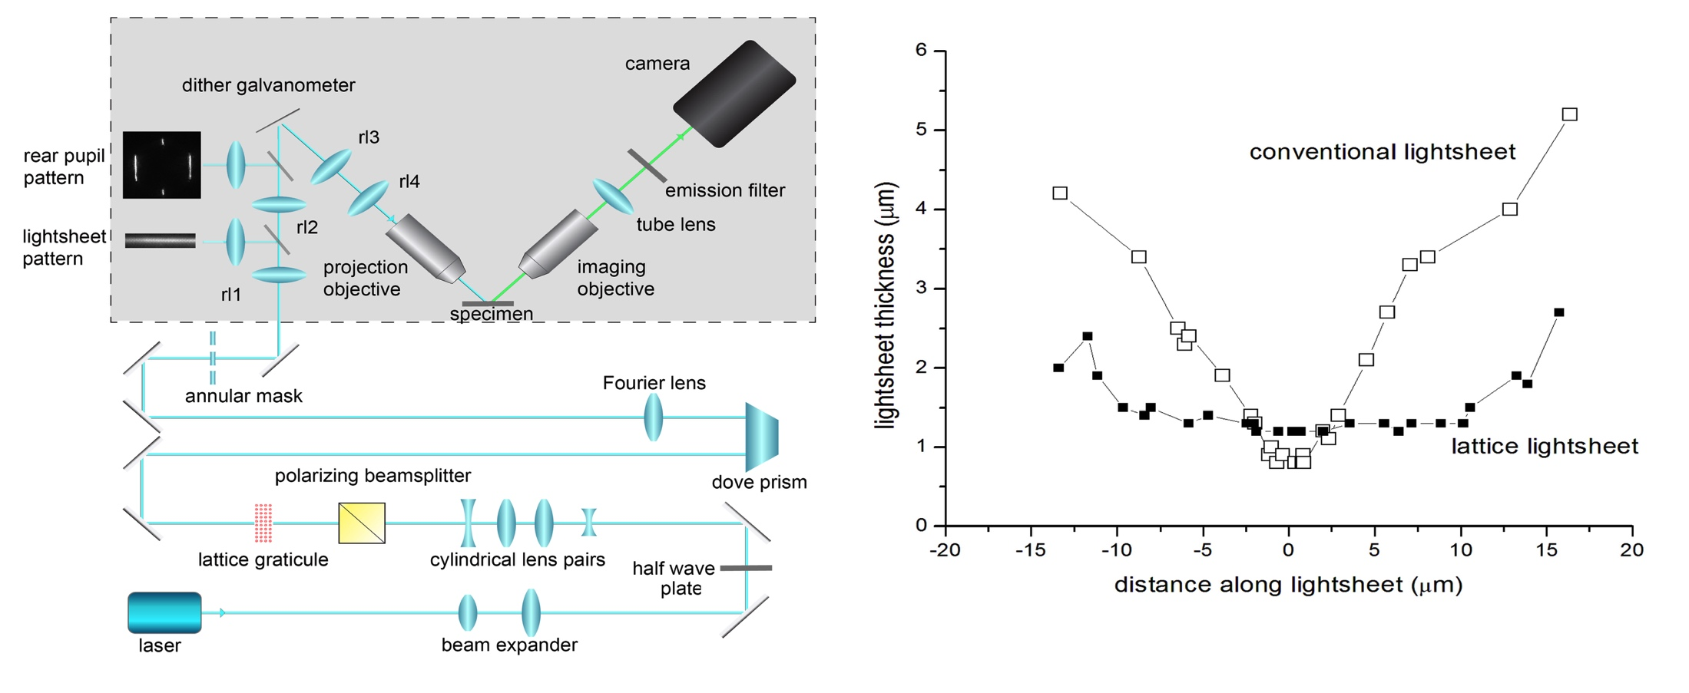
Lattice light-sheet microscopy
Imaging an optical section by projecting a thin sheet of light diagonally through cells

Slide 32
Ca²⁺ signals in the cell interior show pulsatile and diffuse patterns similar to signals near the PM imaged by TIRF
Light-sheet imaging of an i-IP₃-evoked global Ca²⁺ spike in a HEK293 cell
Raw fluorescence
SD signal
periphery
interior

Slide 33
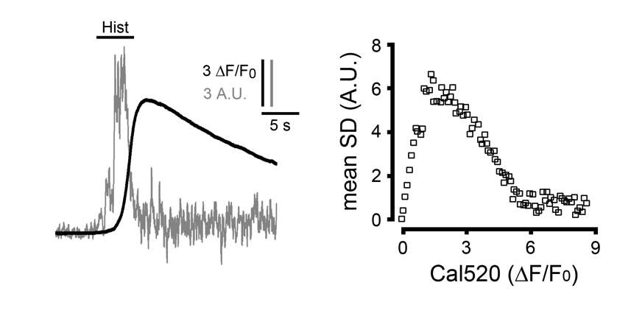
Pulsatile and diffuse components of Ca2+ release are ubiquitous in many cell types
e.g. HeLa cell
and
SHSY-5Y neuroblastoma
MDA breast cancer

